Slide 1
Data for decision making, policy and delivery
Civil Service Live
#CivilServiceLive
@UKCivilService

Slide 2
Speaker name
Speaker title
#CivilServiceLive
@UKCivilService

Slide 4
What is data science?

Slide 5
The result of:
Mathematical/statistical theory
Very cheap computing resources
More data than ever before

Slide 6
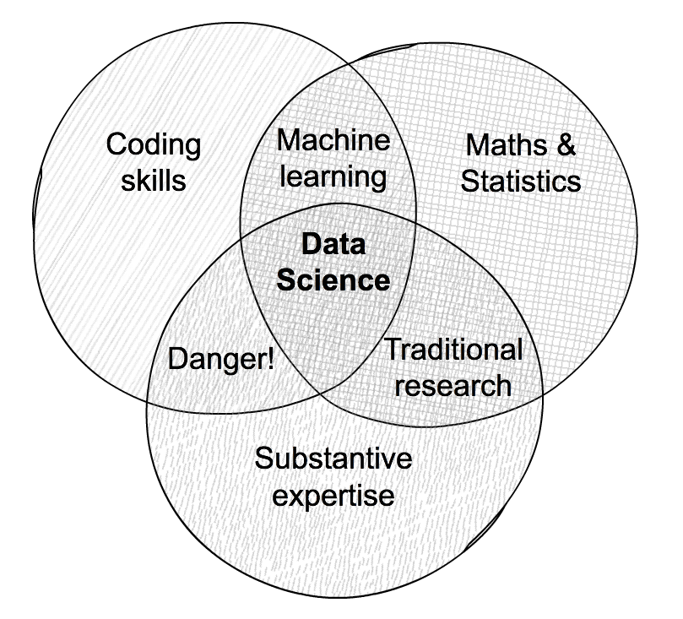
Lots of venn diagrams...

Slide 7
Where is data science right now?

Slide 8
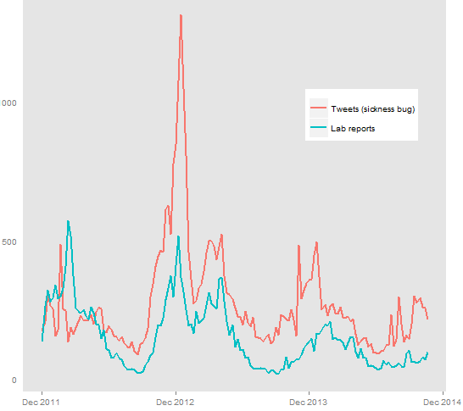
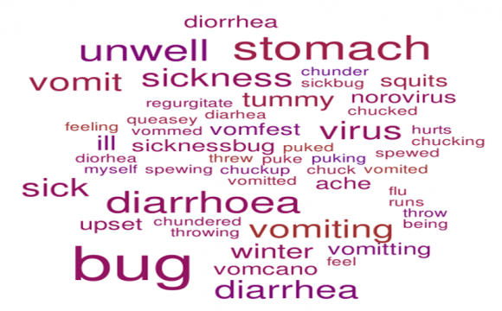
Predicting Norovirus using social media

Slide 9
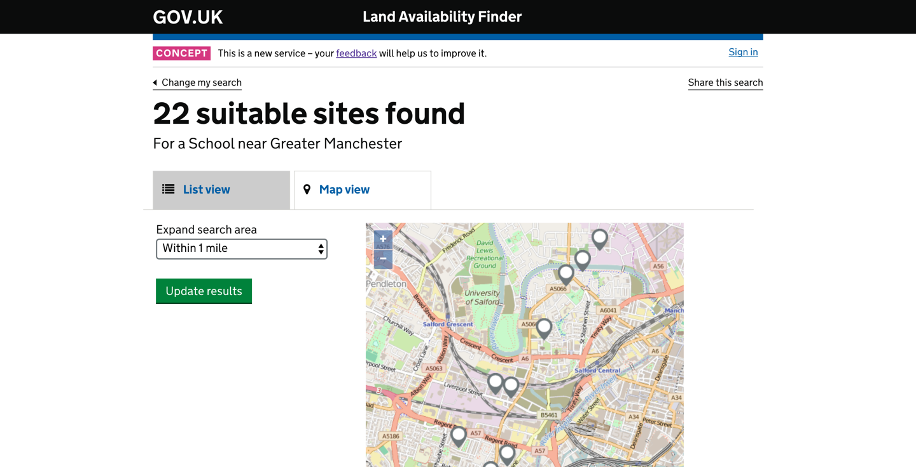
Sourcing appropriate land for schools

Slide 10
Where is data science in government heading?

Slide 11
Data science is easy: culture and infrastructure are hard

Slide 12
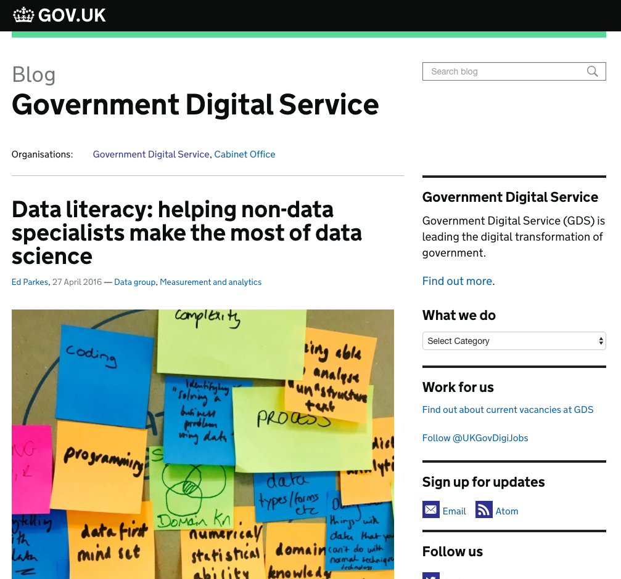
Government needs to be an informed customer

Slide 13
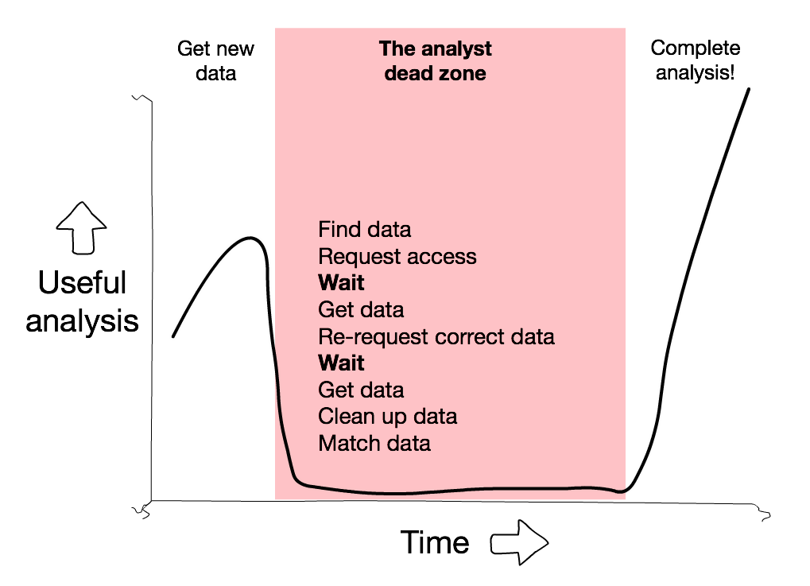
Getting hold of data can be hard

Slide 14
Guest speaker

Slide 15
Capability and community

Slide 16
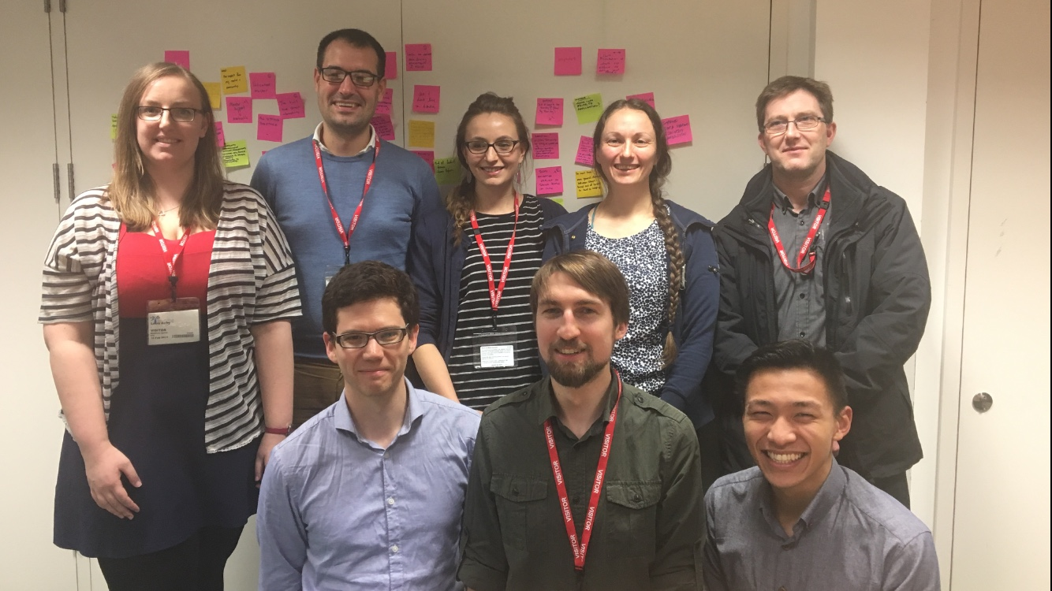
Data Science Accelerator

Slide 17
Apprenticeships for Data Analytics
MSc Data Analytics for Government

Slide 18
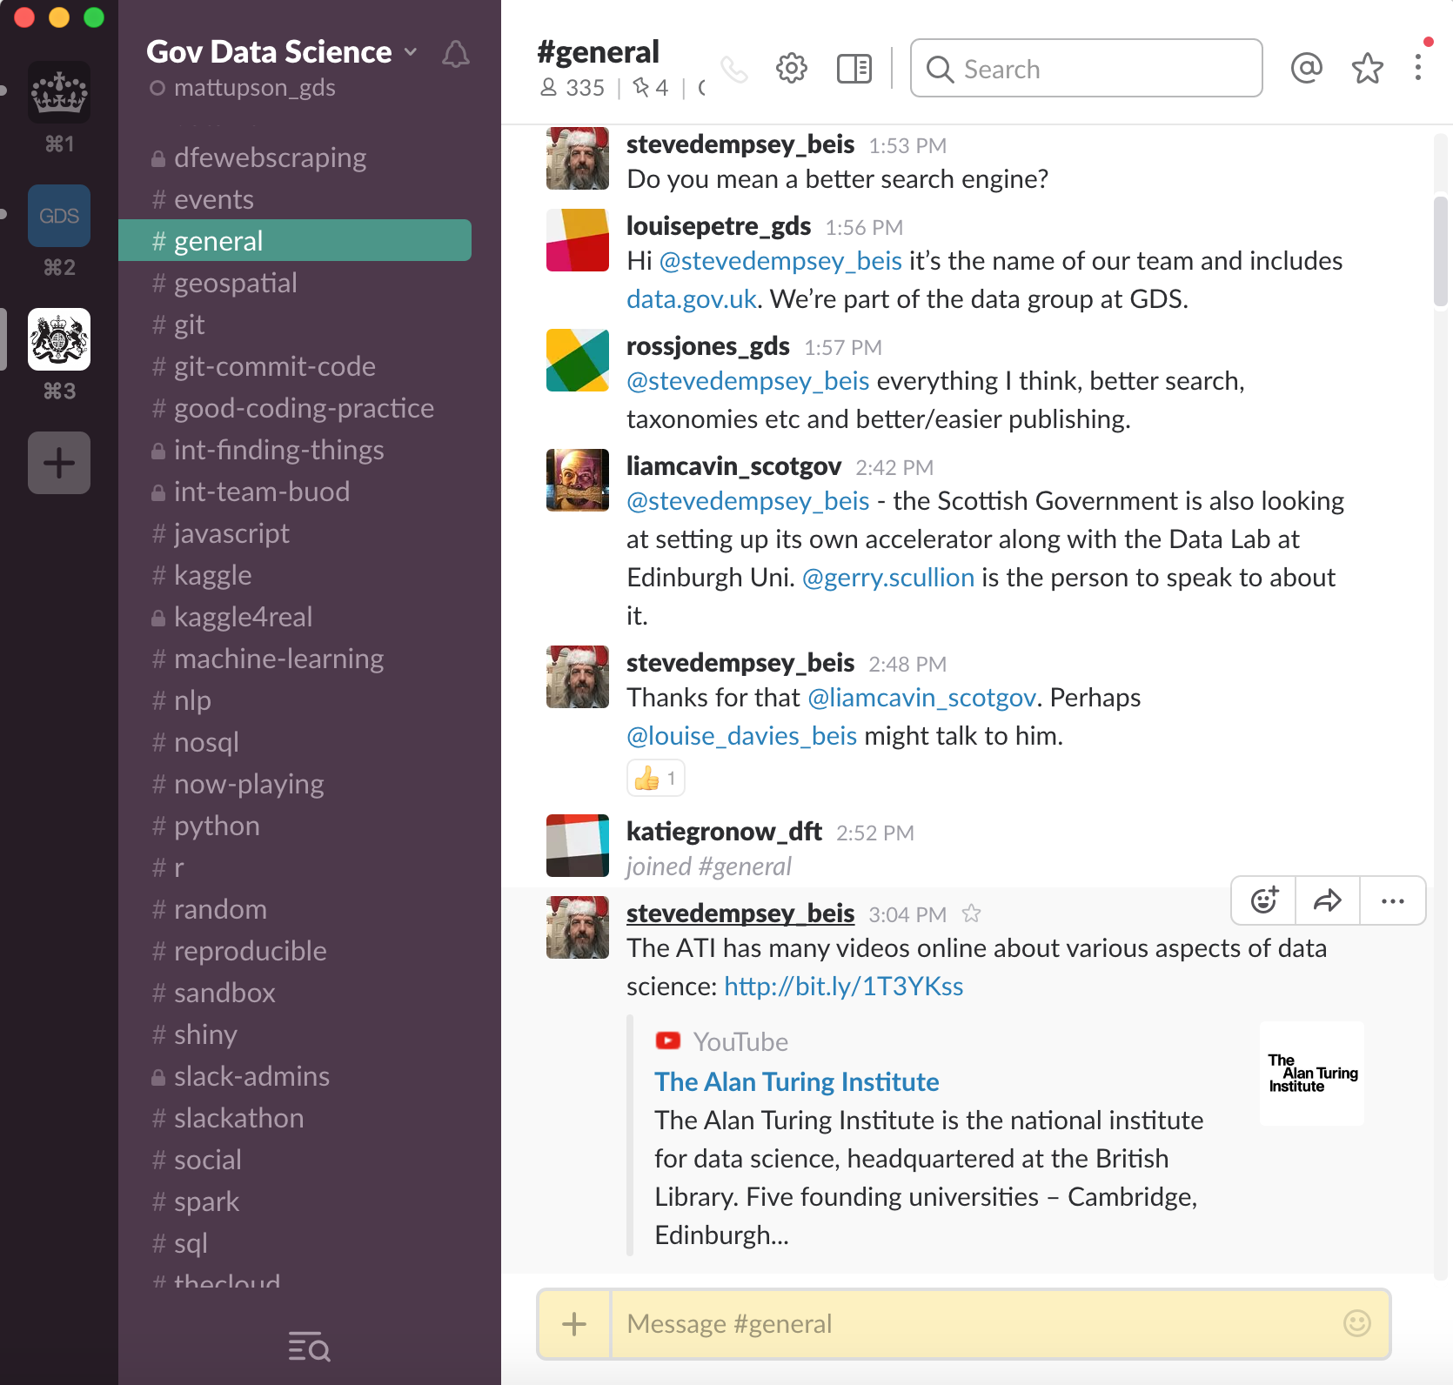
Community

Slide 19
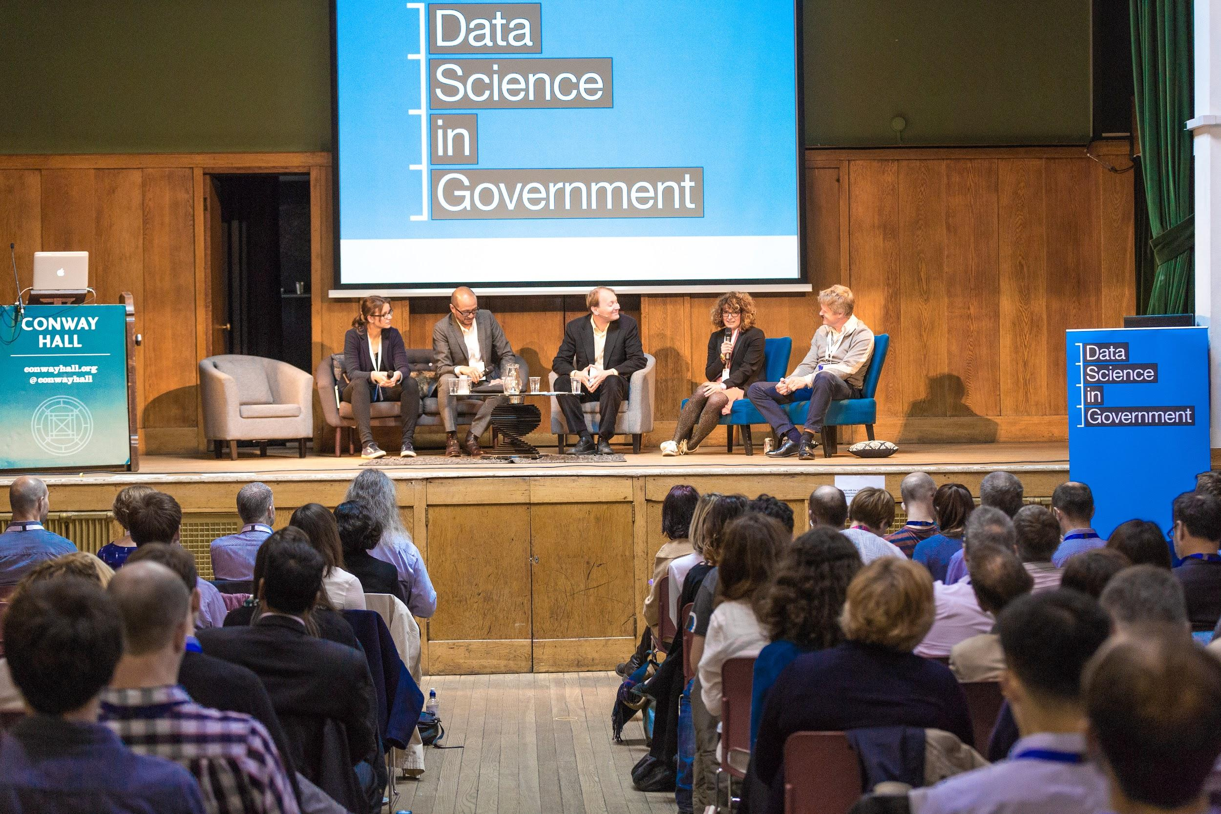
First Government Data Science Conference

Slide 20
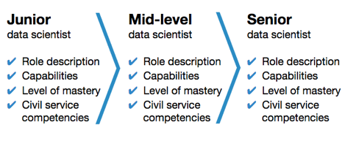
Career path

Slide 21
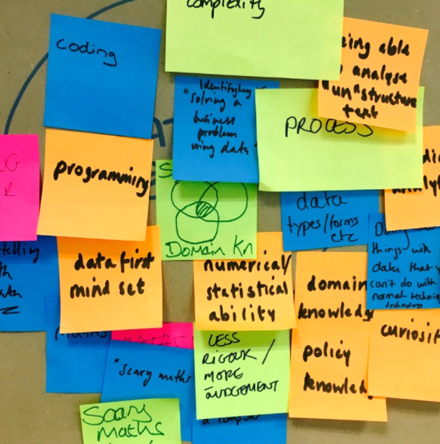
Art of the Possible

Slide 22
Questions

Slide 23
Thank you!
#CivilServiceLive
@UKCivilService

